Slide 1
Chapter 6
Applications of Definite Integrals
Copyright © 2010 Pearson Education, Inc. Publishing as Pearson Addison-Wesley

Slide 2
6.1
Volumes Using Cross-Sections
Copyright © 2010 Pearson Education, Inc. Publishing as Pearson Addison-Wesley

Slide 3
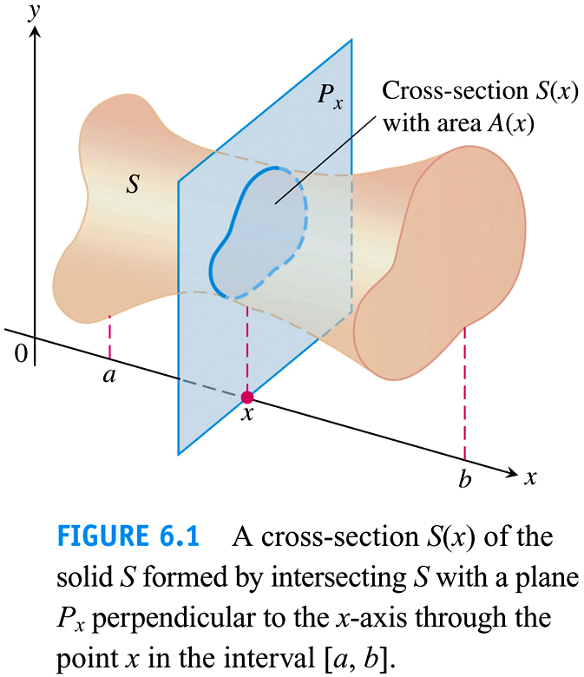

Slide 4
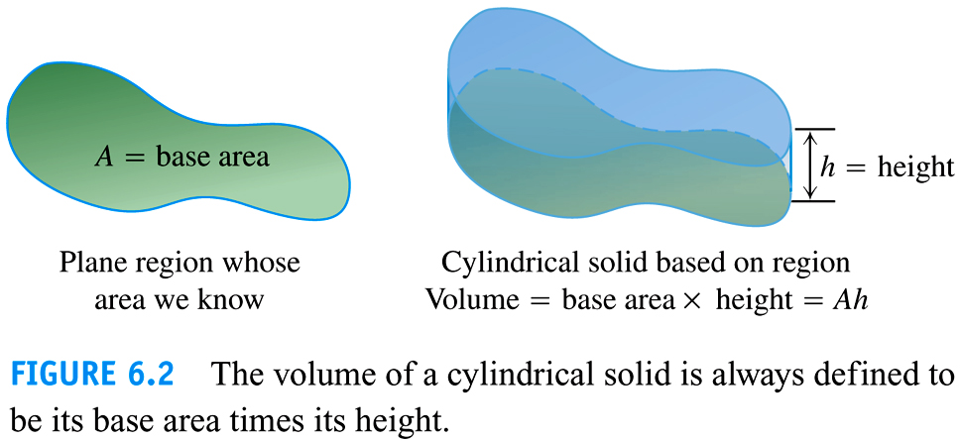

Slide 5
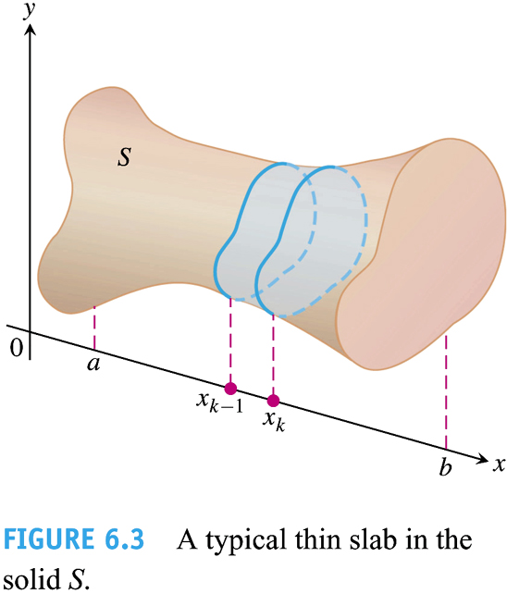

Slide 6
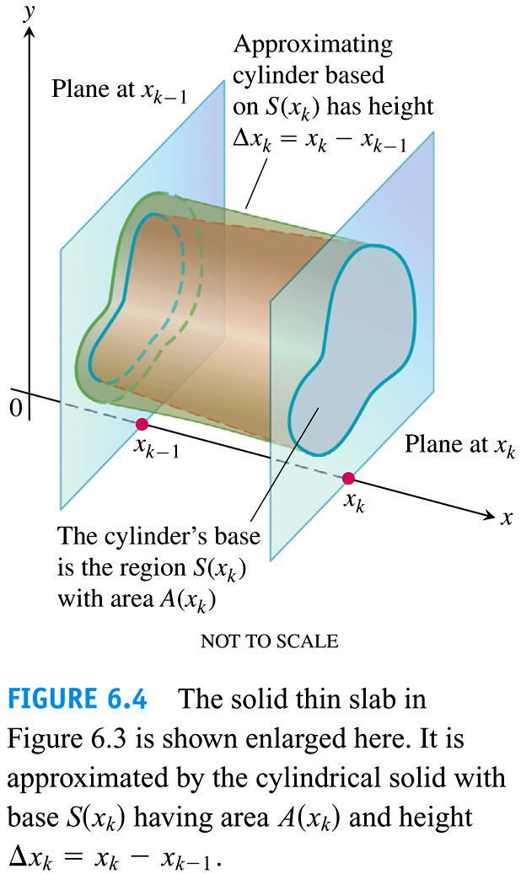

Slide 7


Slide 8


Slide 9
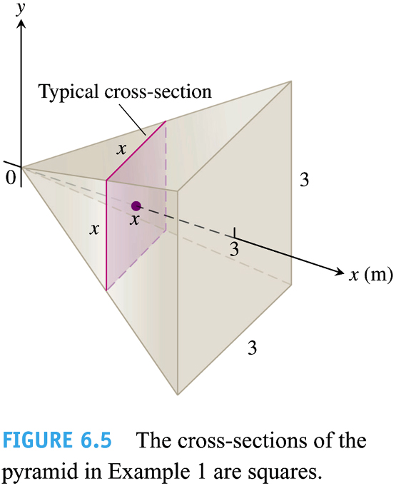

Slide 10
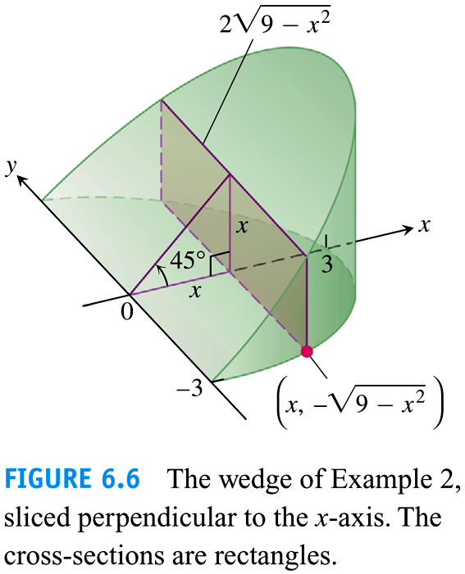

Slide 11
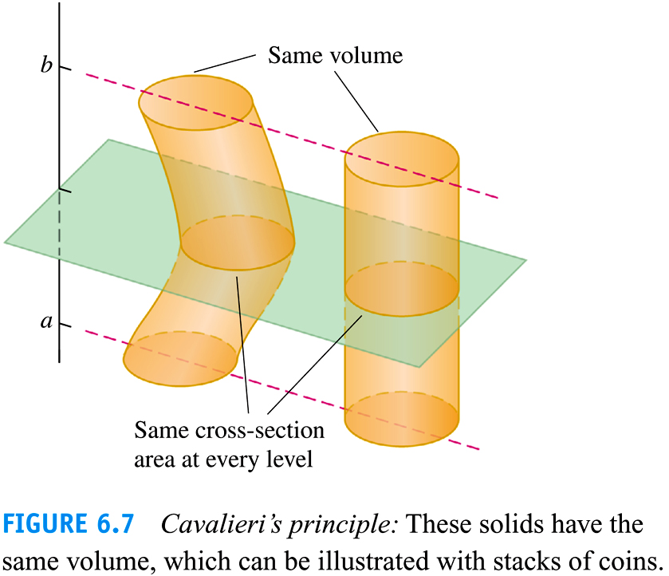

Slide 12
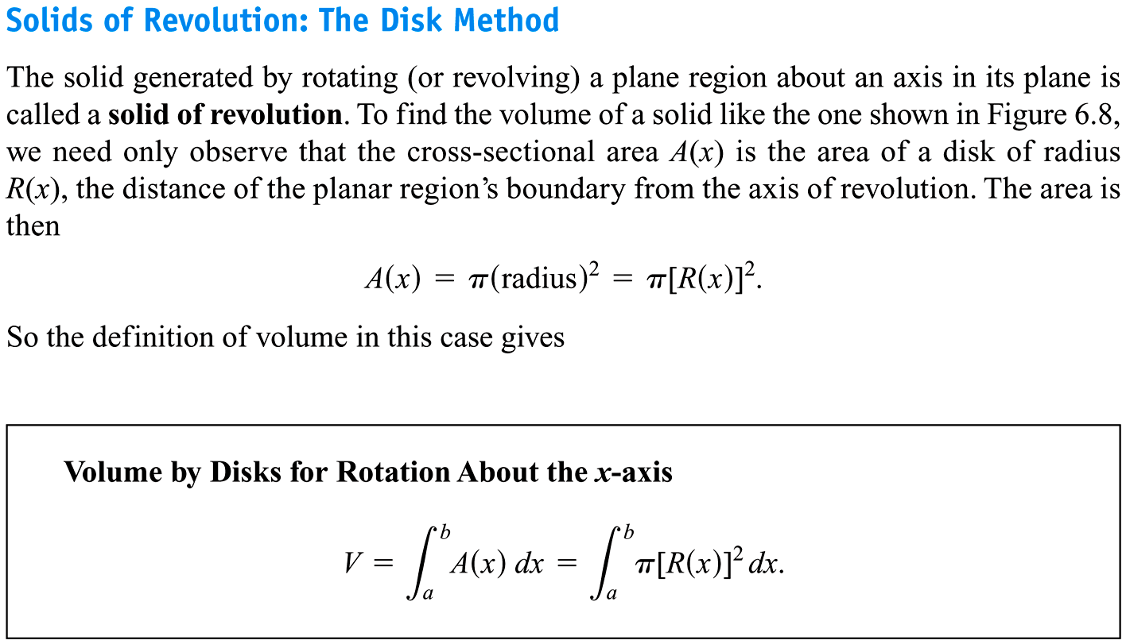

Slide 13
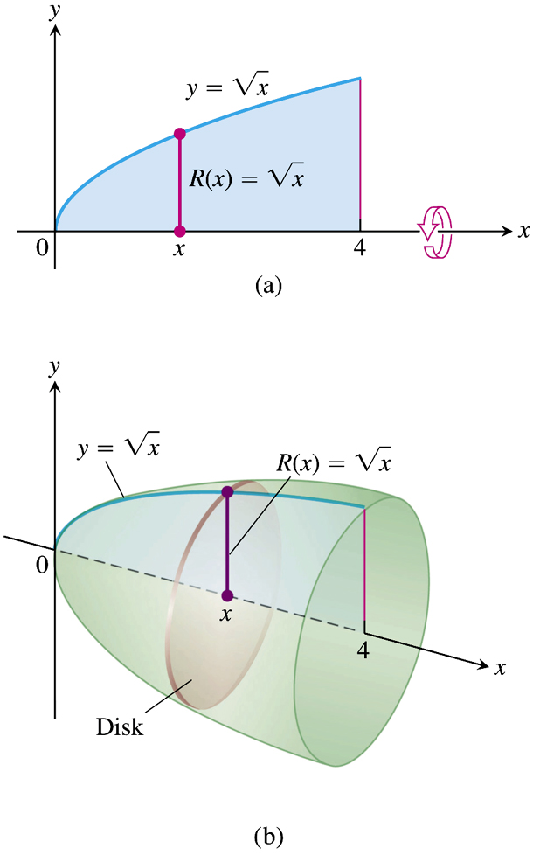


Slide 14
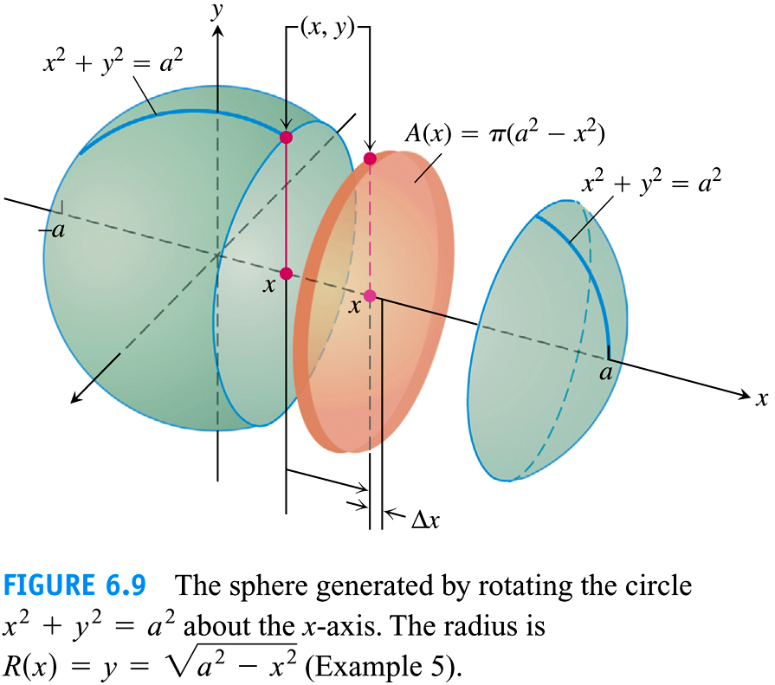

Slide 15
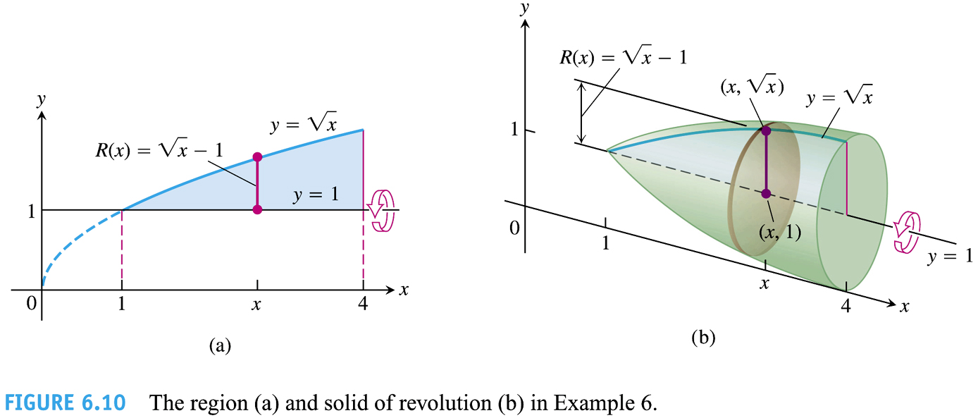

Slide 16
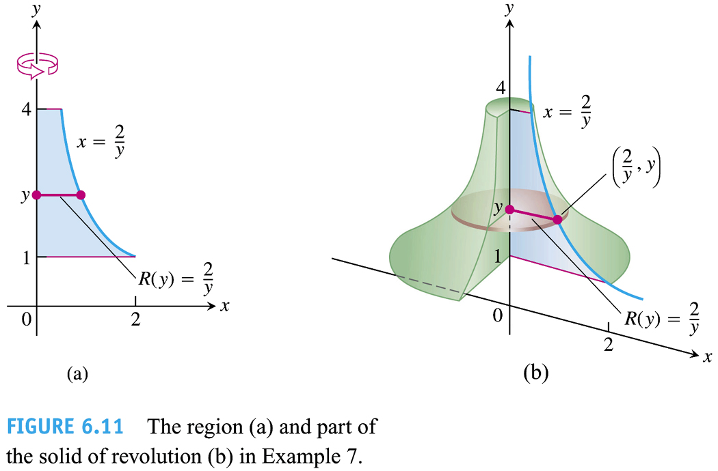

Slide 17
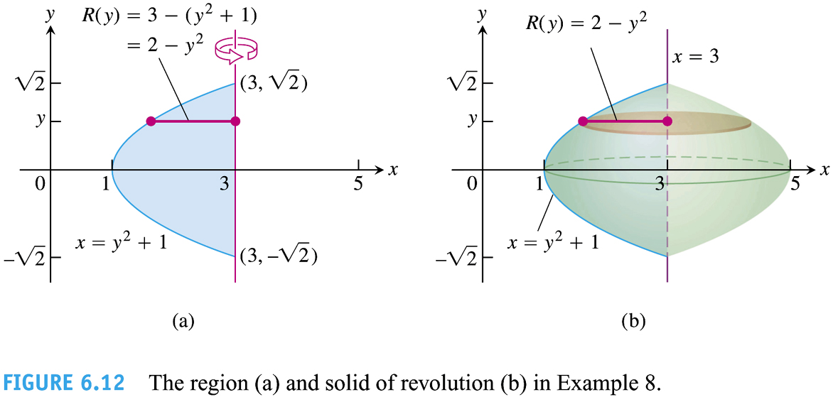

Slide 18
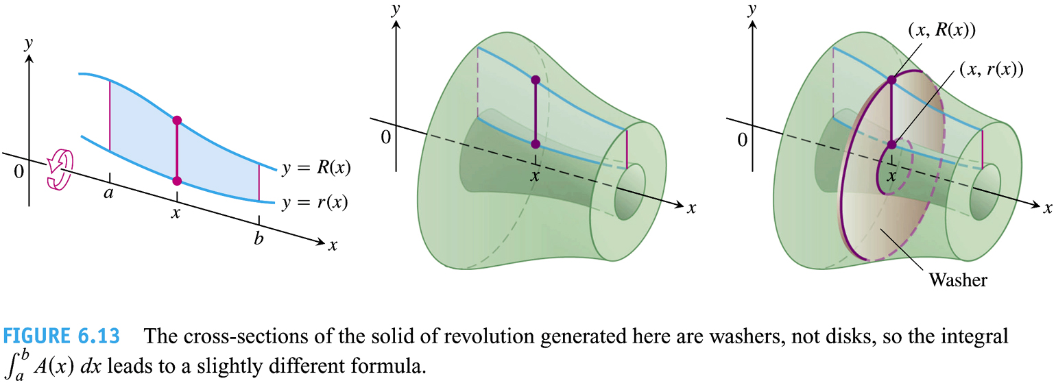

Slide 19
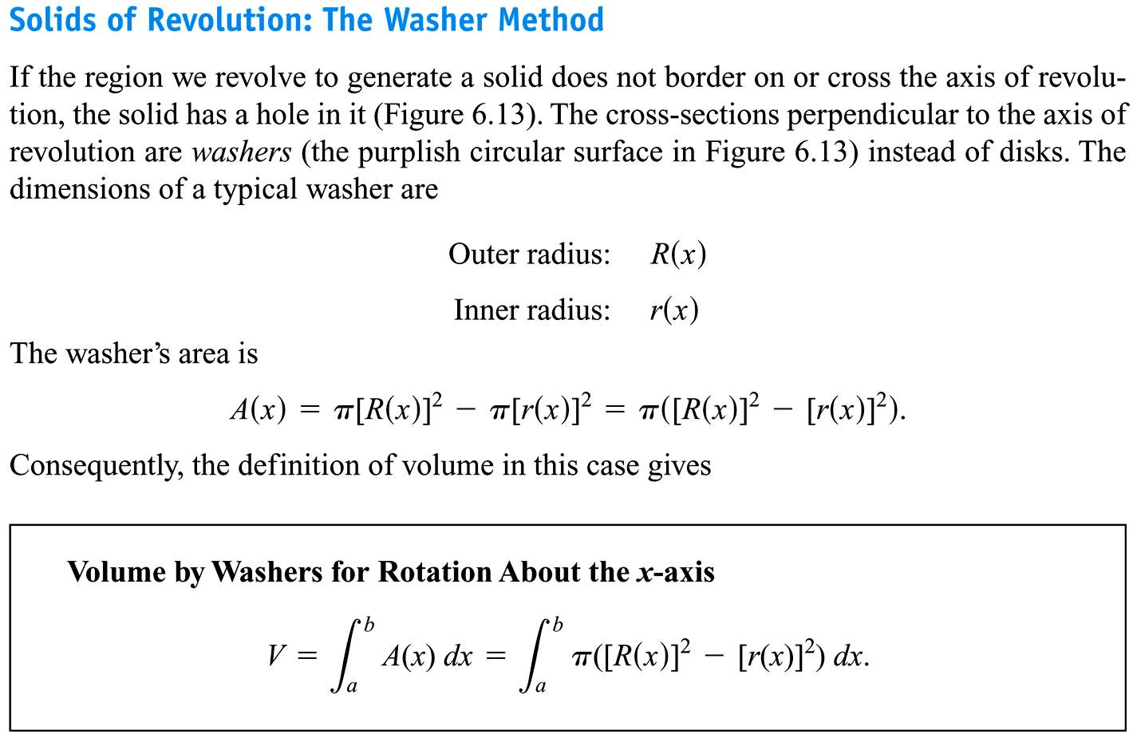

Slide 20
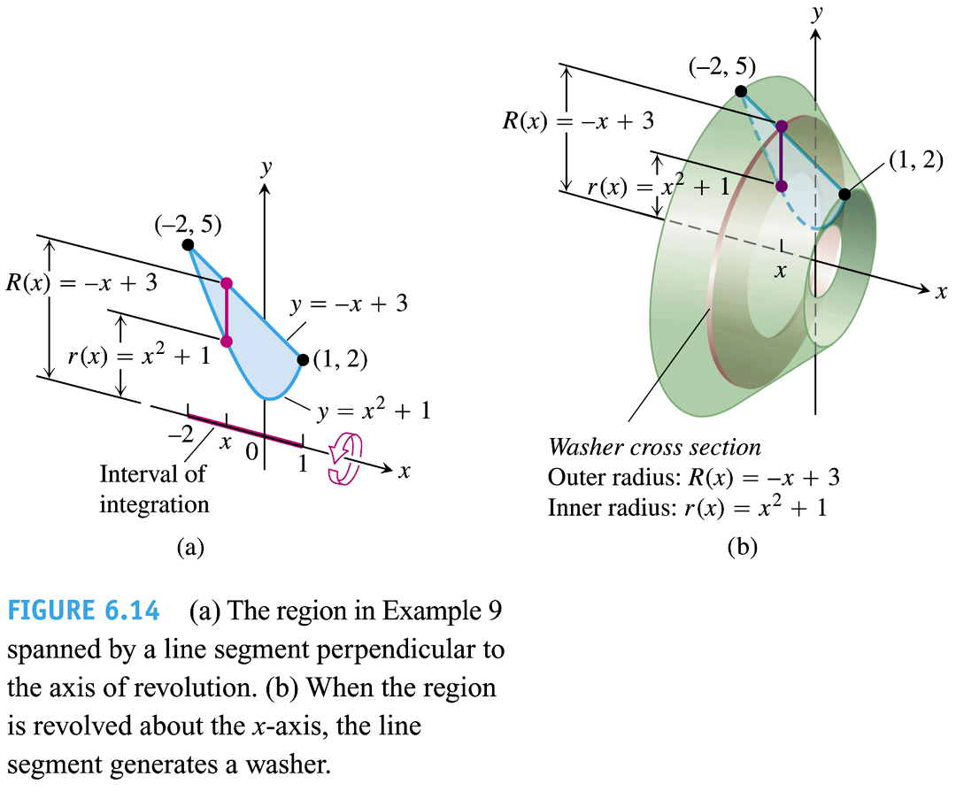

Slide 21
6.2
Volumes Using Cylindrical Shells
Copyright © 2010 Pearson Education, Inc. Publishing as Pearson Addison-Wesley

Slide 22
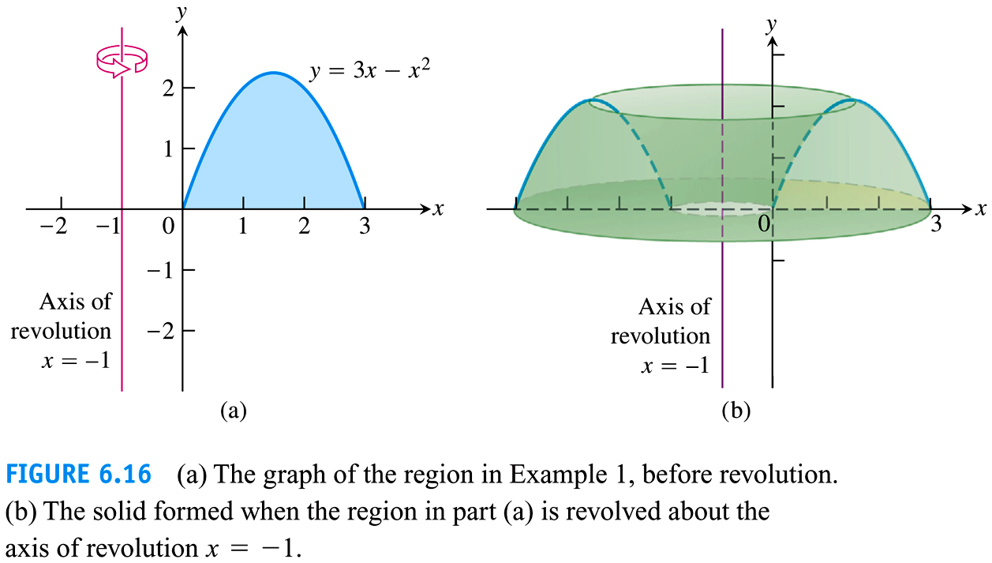

Slide 23
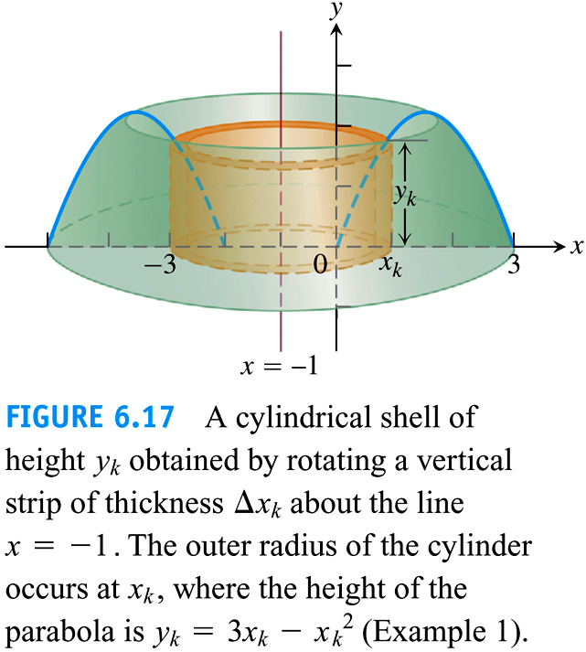

Slide 24
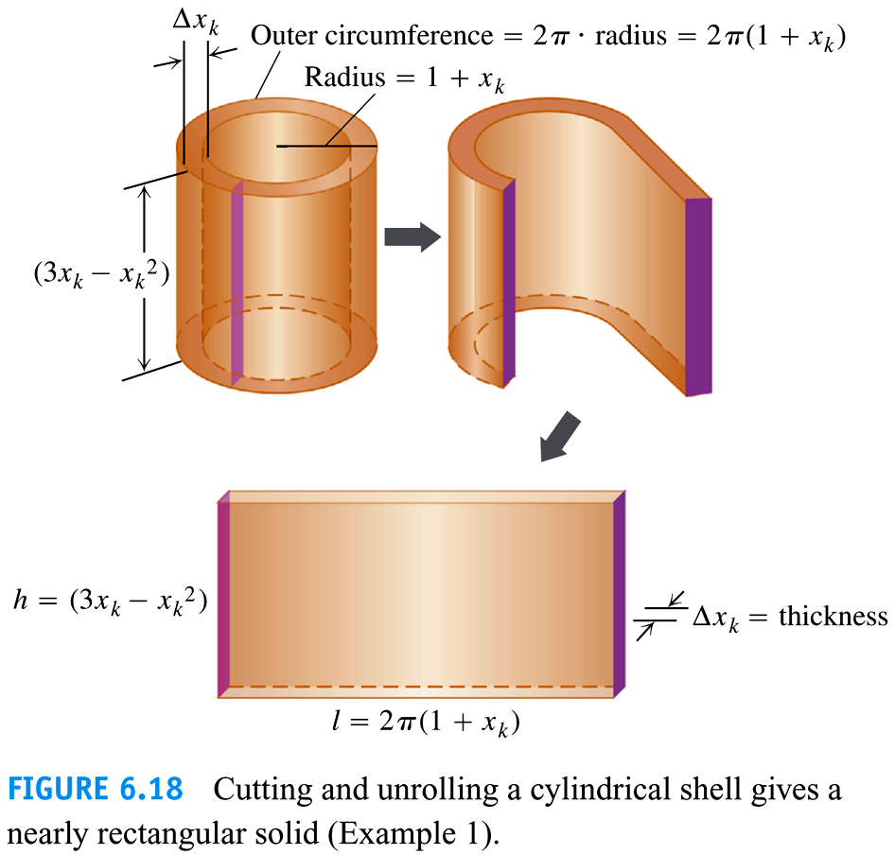

Slide 25
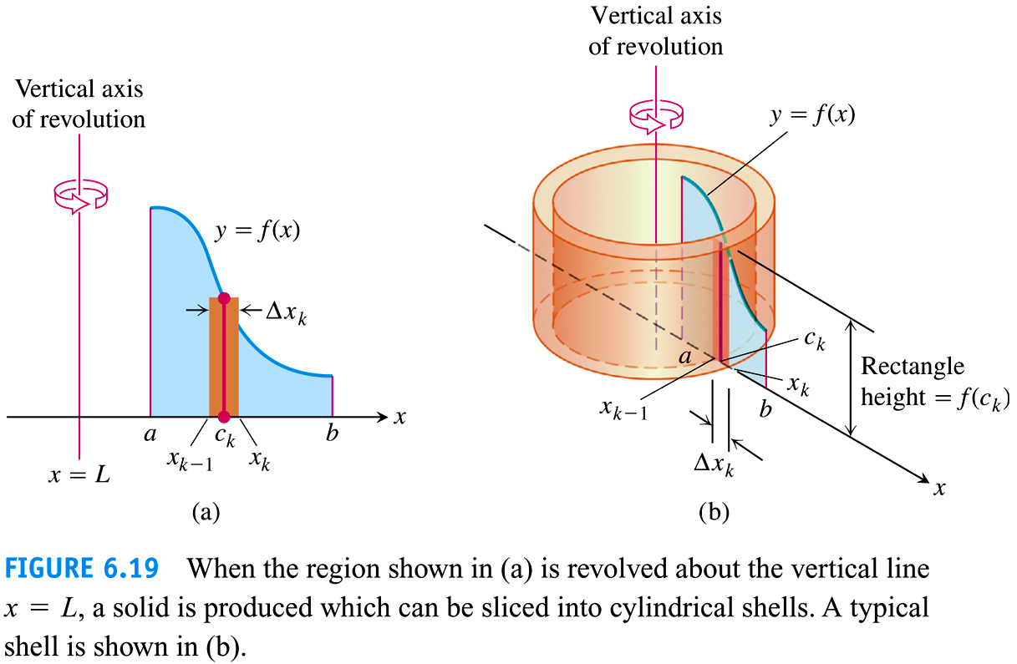

Slide 26


Slide 27
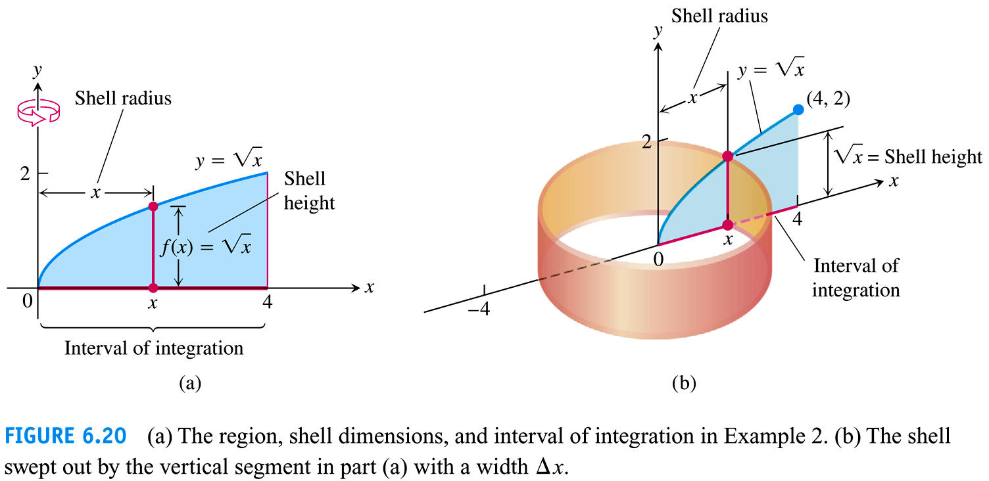

Slide 28
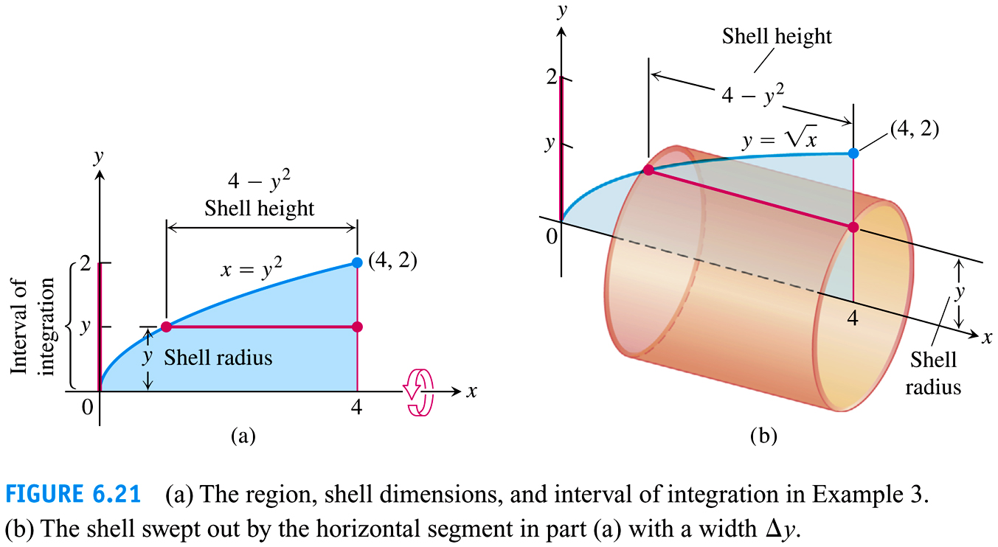

Slide 29
